Slide 1

Mo-Trust
Mo-People
Mo-Money
Mo-Speed
Introducing MoMoMore, a FinTech app that aims to transform the MTN MoMo experience by addressing key pain points.

Slide 2
We Bring…
Mo-Trust
Mo-People
Fast Fraud Detection
AI-Powered.
Accurate – Collection of recent Data
For Our Communities (money circulates)
Rewards Your Loyalty
Your history works for you.
Mo-Money
Mo-Speed
The World's Fastest Loan
Pre-Approved Funds
Get funds in seconds
Decisions in Seconds
No Waiting Ever
Access to instant money in services (PayShap)

Slide 3

DEMO: How it works?
Leveraging AI and integrated data to build trusted, secure, and instant digital financial services for MTN MoMo customers

Slide 4







4 Pillars of MoMoMore
Mo-Trust
Mo-People
Mo-Loans
Mo-Speed

Slide 5
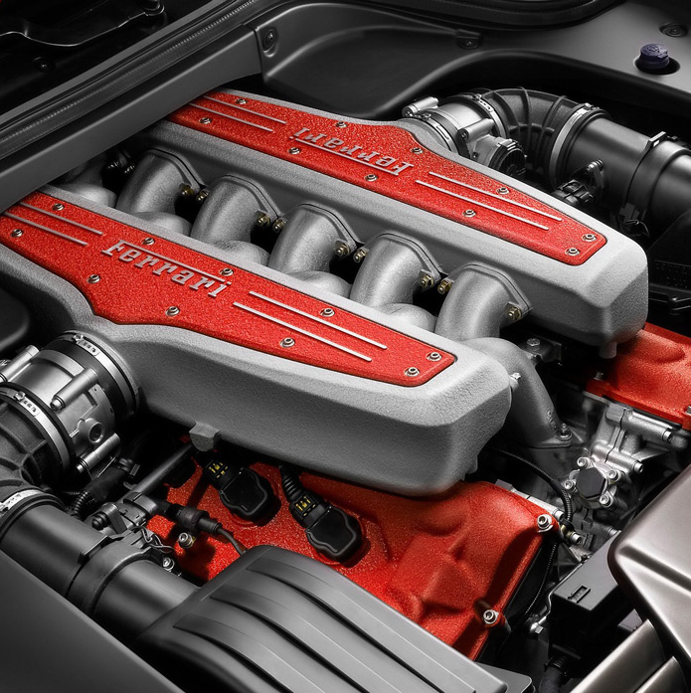
API’s USED
Under the hood
1. Get User Info (KYC)
Use: Verify user identity & build trust foundation after consent.
URL: GET /v1_0/accountholder/msisdn/{phoneNumber}/basicuserinfo
2. Get Transaction History
Use: Analyze financial behavior to calculate the AI TrustScore.
URL: GET /v1_0/account/transaction
3. Request to Pay (Disburse)
Use: Send the approved loan instantly to the user's wallet.
URL: POST /collection/v1_0/requesttopay
4. Request to Pay (Repay)
Use: Collect loan repayment from the user on the due date.
URL: POST /collection/v1_0/requesttopay
5. Get Account Balance
Use: Check wallet status as a key trust signal.
URL: GET /v1_0/account/balance

Slide 6



Seamless Integration
Instant Payments
Mobile-Friendly Dashboards
User-Centric Experience
1. Customer Data & Identity Platform
Use: Securely access and merge user data from across all MTN services (e.g., mobile, fixed-line, ISP) for a 360-degree view.
Example: GET /internal/customer/{msisdn}/profile
2. Network Signaling & Location API
Use: Analyze location patterns and consistency (a strong fraud indicator) from cell tower data.
Example: GET /internal/network/{msisdn}/location-consistencybehaviour
3. Risk & Blacklist Service
Use: Cross-reference a user's social graph (hashed contacts) against internal databases of known fraudulent numbers.
Example: POST /internal/risk/check-social-graph
4. Telco Payment Behavior API
Use: Analyze history of airtime purchases, bill payments, and mobile money usage for financial reliability.
Example: GET /internal/billing/{msisdn}/payment-behaviour

Slide 7
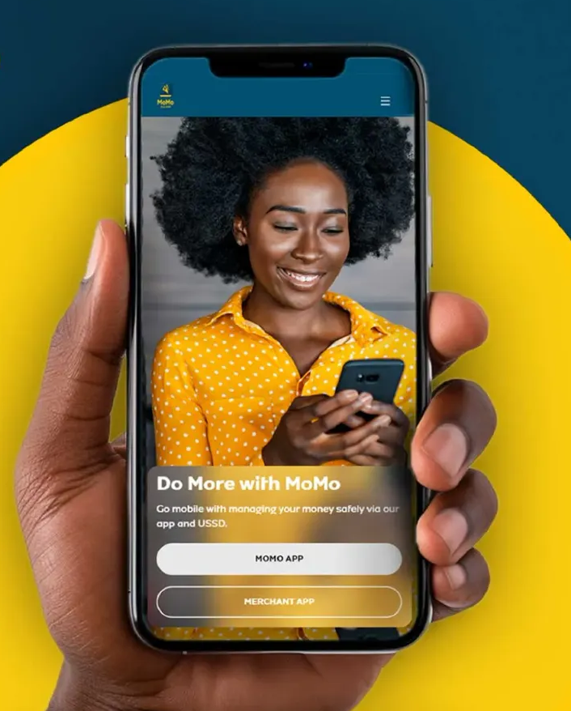
MoMoMore empowers MTN customers to transact with confidence and convenience.
MoMoMore elevates the MTN MoMo Brand
IT driving financial inclusion more people have access to loans and other services

Slide 8
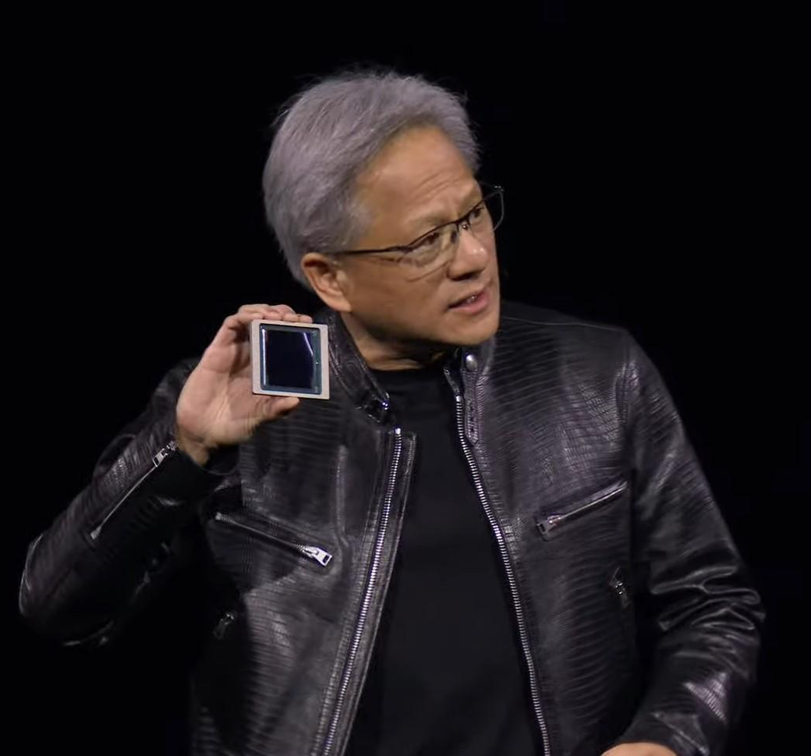
Powering Trust with AI
Core Technology: MoMoMore utilizes proprietary, cutting-edge AI models for real-time fraud detection and customer trustworthiness validation.
Strategic Infrastructure: The system is powered by high-performance computing, leveraging NVIDIA's AI platforms to process vast datasets at unprecedented speeds.
Executive Insight: As NVIDIA CEO Jensen Huang states, "AI is the most powerful technology force of our time." MTN is harnessing this force to build the most secure financial ecosystem in Africa.
Tangible Outcome: This AI-driven approach proactively safeguards every financial transaction on the MoMo platform, dramatically reducing fraud losses and building unparalleled customer trust.
The Result: A safer, more reliable, and instantly responsive Mobile Money experience for every MTN customer.

Slide 9
MoMo More Team
Earl,
Earnest,

